Slide 1
Health Awareness and Nutrition
Diabetes Mellitus
Department of Clinical Nutrition and Dietetics
College of Health Sciences

Slide 2
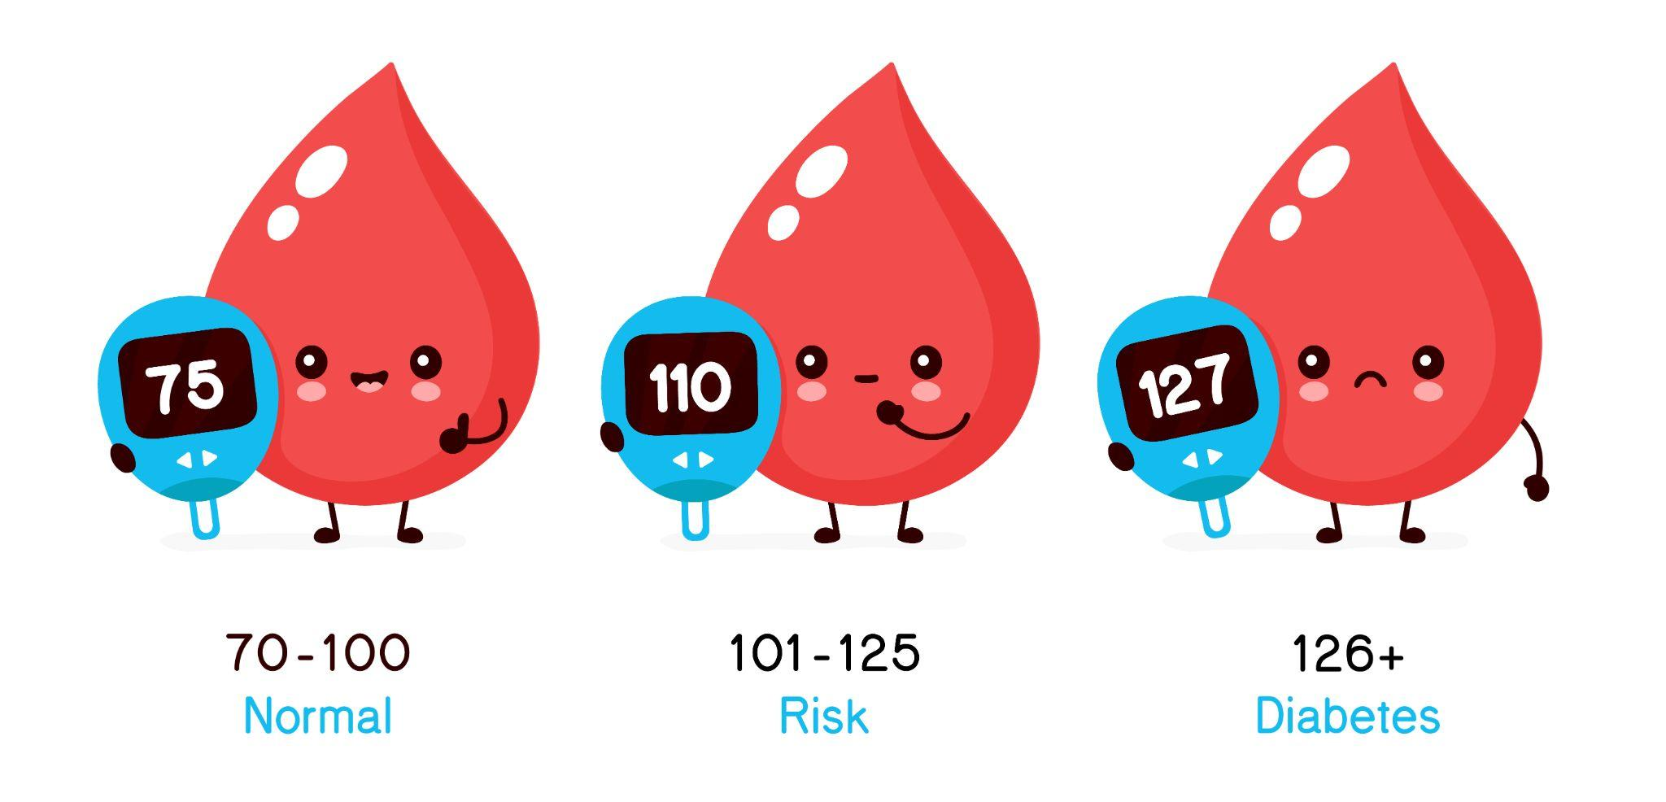
Diabetes Mellitus
It is a group of metabolic diseases in which a person has high blood glucose
It caused by the partial or complete failure of the pancreas to secrete insulin, which leads to an increase in the level of sugar in the body
The body does not produce enough insulin
Cells do not respond to the insulin that is produced
Insulin is the principal hormone that regulates uptake (absorption) of glucose from the blood into most cells
Deficiency of insulin plays a central role in all forms of diabetes mellitus

Slide 3
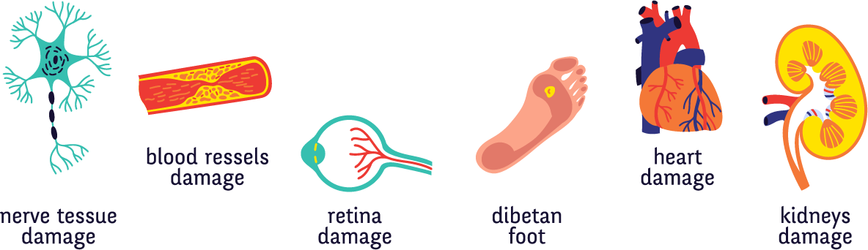
Health Complications
It is a chronic disease that causes health complications including:
Kidney failure
Heart disease
Stroke
Blindness
Symptoms of DM include: frequent urination, lethargy (laziness), excessive thirst, and hunger.
Management of DM includes: changes in diet, oral medications, and insulin injections.

Slide 4
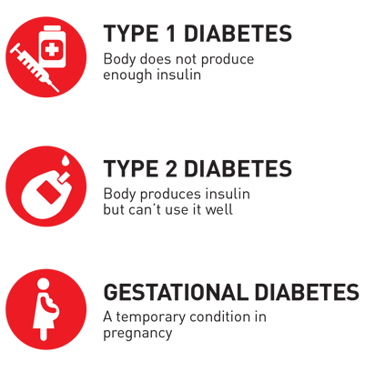
Classification of Diabetes
Clinical Types:
Type 1: IDDM (Insulin Dependent Diabetes Mellitus)
Type 2: NIDDM (Non-Insulin Dependent Diabetes Mellitus)
IGT: (Impaired Glucose Tolerance) Also known as Prediabetes
Gestational Diabetes Mellitus: Pregnancy induced diabetes

Slide 5

Classification of Diabetes
Type 1 Diabetes Mellitus:
It is characterized by loss of the insulin-producing cells in the pancreas, leading to insulin deficiency.
There is no known preventive measure against type 1 diabetes.
Most affected people are healthy.
Type 1 diabetes affects mainly children.
At Risk Groups: not definite but could be children of parents with Diabetes

Slide 6
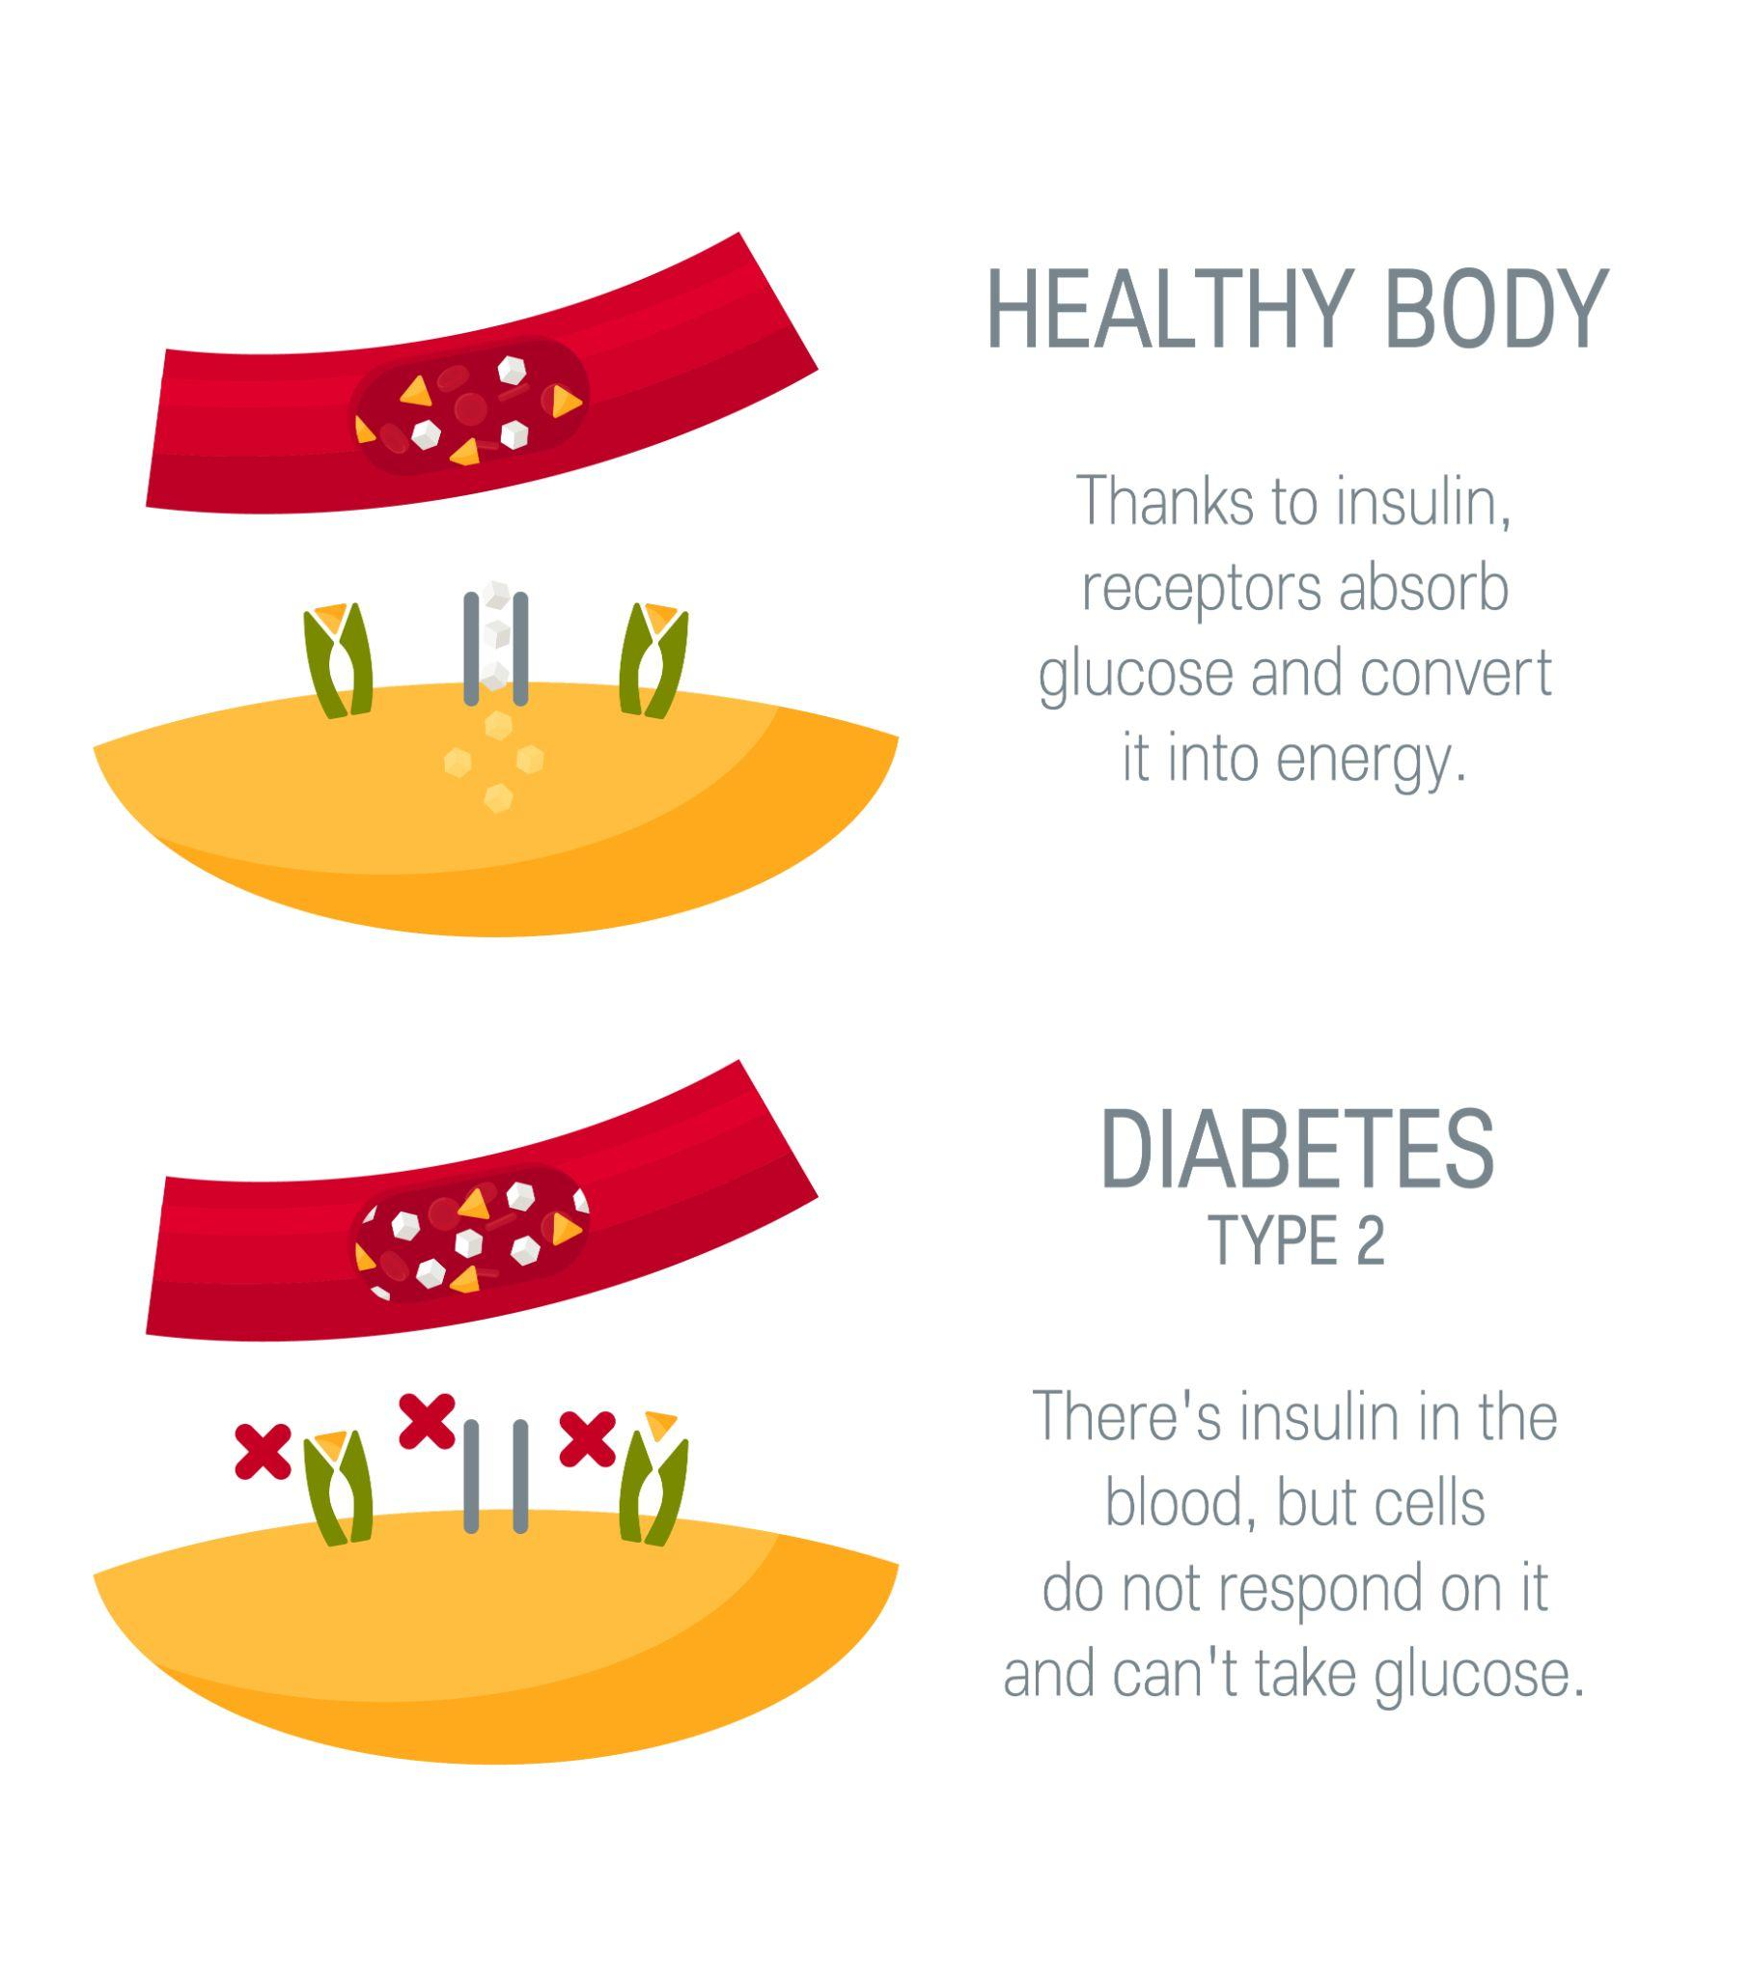
Classification of Diabetes
Type 2 Diabetes Mellitus:
It is characterized by insulin resistance, which may be combined with relatively reduced insulin secretion.
In the early stage of type 2, hyperglycemia can be reversed by a variety of measures and medications.
Type 2 diabetes is the most common type, and mainly among adults.
At Risk Groups: overweight, obese with family history.

Slide 7

Classification of Diabetes
IGT (Impaired Glucose Tolerance):
Abnormal blood glucose levels from any cause which results in disease.
A condition resulting from a disorder of blood sugar metabolism.
IGT may precede type 2 diabetes mellitus by many years.

Slide 8

Classification of Diabetes
Gestational Diabetes Mellitus (GDM):
GDM resembles type 2 diabetes.
It occurs in about 2–5% of all pregnancies and may improve or disappear after delivery.
About 20–50% of affected women develop type 2 diabetes later in life.
If it is untreated during pregnancy, can damage the health of the fetus or mother.
At Risk Groups: females whose mothers had GDM while pregnant.

Slide 9
Diagnosis of Diabetes Mellitus
OGTT Criteria (Oral Glucose Tolerance Test)
Time | (mg/100 ml of blood)
 | Normal | IGT | DM
Fasting | <100 | >100 <120 | >120
2 hours | <120 | 120-180 | >180

Slide 10
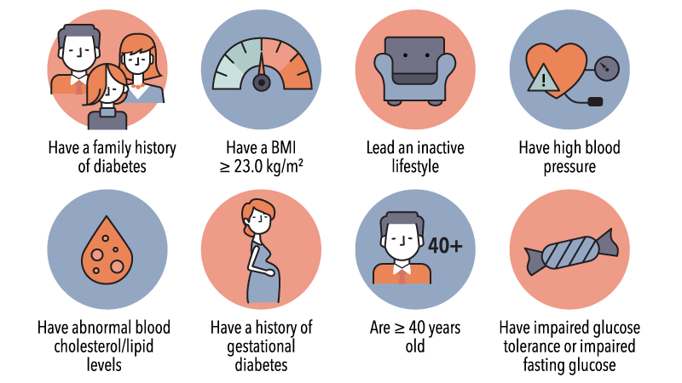
Risk Factors
Common Risk Factors:
Heredity
Age
Gender
Obesity
Faulty dietary habits
Infections
Stress
Other hormonal diseases

Slide 11
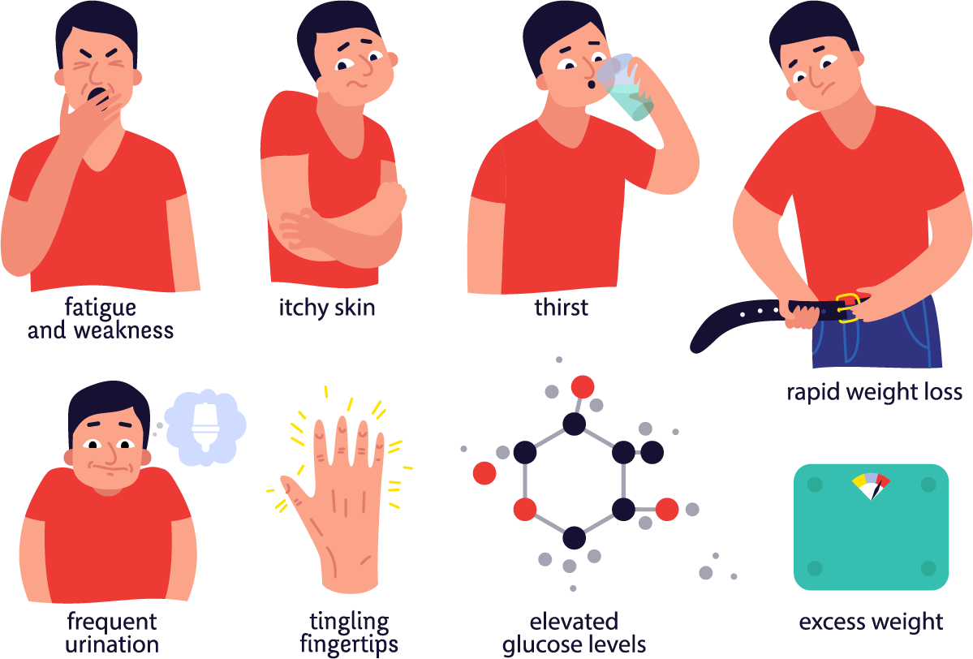
Clinical Manifestations
Signs and Symptoms:
Polyphagia (hunger)
Polyuria and nocturia (urination, particularly at night)
Polydipsia (thirst)
Dehydration causing water & electrolyte imbalance
General weakness
Decreased resistance to infection
Fungal infections
Breathing deep and rapid, with acetone smell
Weight loss

Slide 12
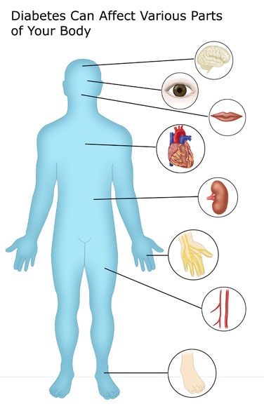
Clinical Manifestations
Advanced Stages:
Blurred vision/failure
Pain
Numbness of limbs
Proteinuria (presence of protein in urine)

Slide 13
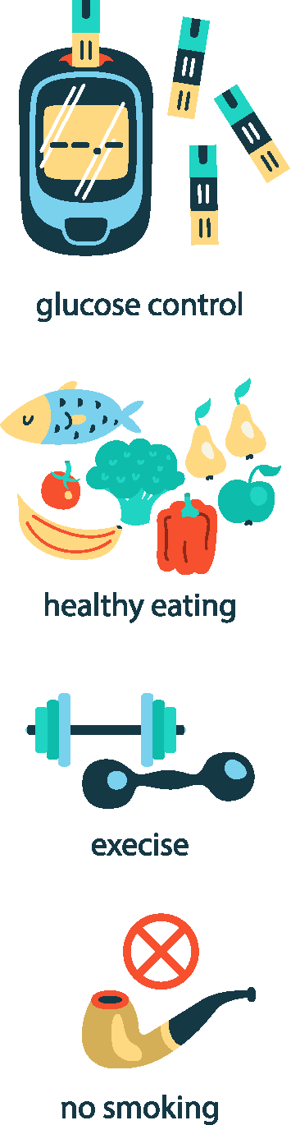
Diet and Diabetes
Diet plays the most crucial role in the management of DM.
Rationale for Dietary Management:
Maintain blood glucose level to normal.
Improve health by attaining & maintaining optimum nutrition.
Attain and maintain desirable body weight.
Prevent/delay the onset of chronic complications and modify diet, if required.
Diet should be as attractive and realistic as possible.

Slide 14

Dietary Advice
Include a lot of fiber in the diet through whole cereals and pulses, other vegetables and fruits with skin & seeds.
Avoid refined cereals, washed pulses, legumes and simple sugar.
Avoid fried & fatty foods eg. egg yolk, organ meats etc
Space carbohydrates in meals according to treatment advised.
Avoid “feasting” and “fasting.”
Remove table sugar from your diet. If required, sweeteners (natural eg. Stevia) can be used moderately.
Avoid alcohol.
In case of complications and associated diseases, the diet may be modified accordingly.

Slide 15
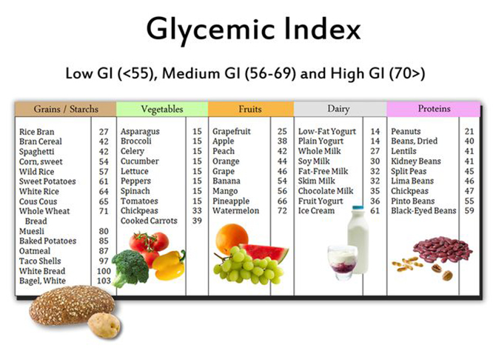
Glycemic Index
Glycemic index (GI) is a value used to measure how much specific foods increase blood sugar levels.
The glycemic index is a tool that is often used to promote better blood sugar management.
Foods are classified as low, medium, or high glycemic foods and ranked on a scale of 0–100.
The lower the GI of a specific food, the less it may affect your blood sugar levels.

Slide 16
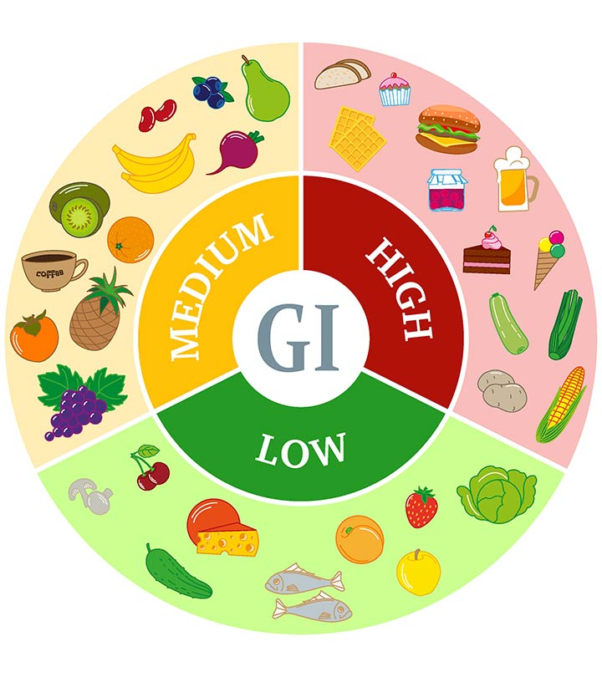
Glycemic Index
The three GI ratings:
Low: 55 or less
Medium: 56–69
High: 70 or above
Foods high in refined carbs and sugar are digested more quickly and often have a high GI.
Foods high in protein, fat, or fiber typically have a low GI.
Foods that contain no carbs are not assigned a GI and include meat, fish, poultry, nuts, seeds, herbs, spices, and oils.

Slide 17
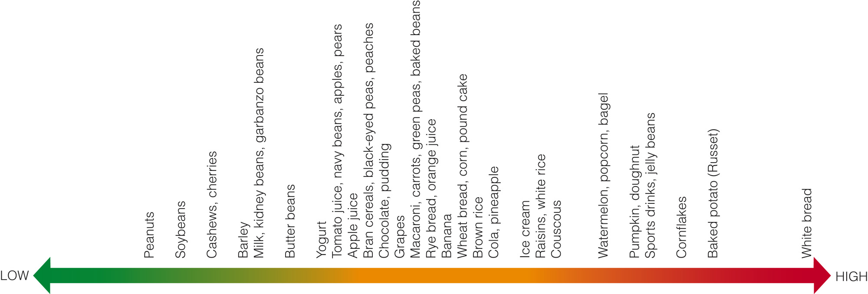
Glycemic Index of Selected Foods

Slide 18

Lifestyle Advice
Regular physical activity is important.
Take care of foot hygiene.
Always carry an ID card indicating name, age, address, contact number, nature of the problem, and type of problem (hyper or hypoglycemia).

